Slide 1
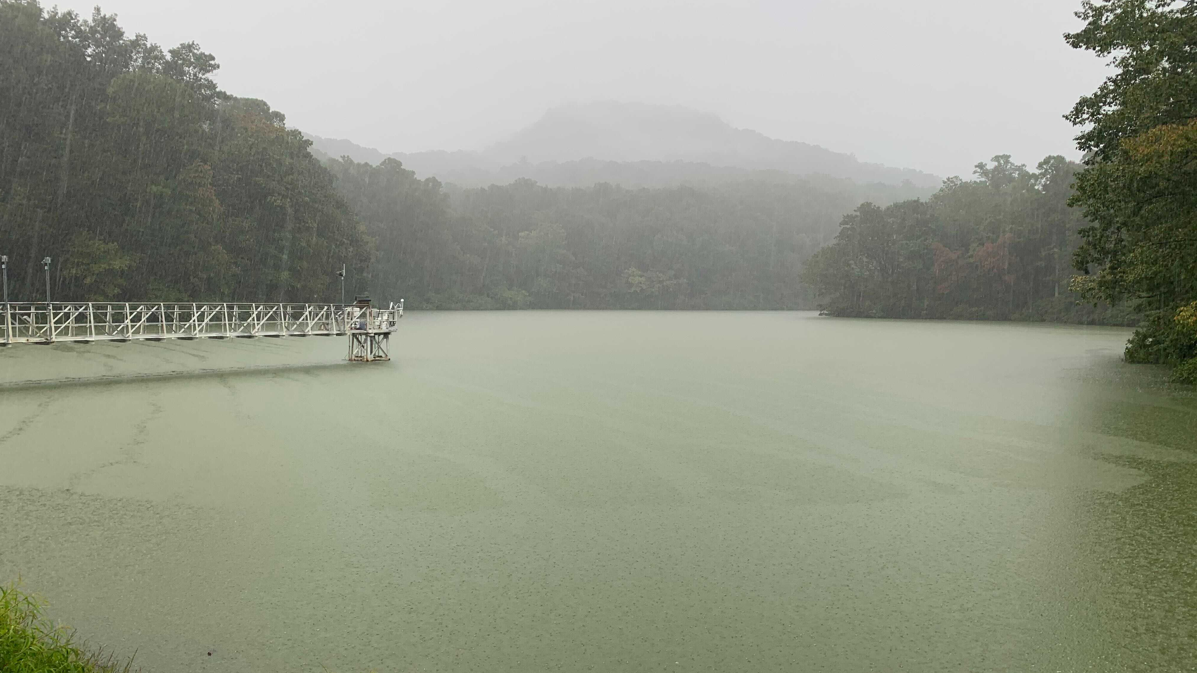

Effects of hypoxia on coupled iron and carbon cycling differ by timescale in two freshwater reservoirs Abigail Lewis, Madeline Schreiber, B. R. Niederlehner, Arpita Das, Nick Hammond, Mary Lofton, Heather Wander, Cayelan Carey
Talk #943
“Carbon fluxes across ecosystem interfaces”
Amway Grand - Concourse Level 2nd Floor - Governor's Room
Thursday, May 19 at 4:30 PM
photo by Heather Wander
Notes:
Highlight Arpita?

Slide 2




Lakes and reservoirs are hotspots for global carbon processing
2 Pg CO₂e
0.12 Pg C
10 Pg CO₂e
0.2–0.6 Pg C
Second State of the Carbon Cycle Report (SOCCR2, 2018)
Notes:
petagrams of carbon

Slide 3


Lakes and reservoirs are hotspots for global carbon processing
2 Pg CO₂e
0.2–0.6 Pg C
LOW
OXYGEN
Second State of the Carbon Cycle Report (SOCCR2, 2018)
Notes:
Sediment-water interface is particularly important
Hotspot for oxygen demand/carbon mineralization
Sink/source of organic carbon under varying conditions

Slide 4
Lakes and reservoirs are hotspots for global carbon processing
2 Pg CO₂e
0.2–0.6 Pg C
LOW
OXYGEN
Second State of the Carbon Cycle Report (SOCCR2, 2018)
Notes:
Sediment-water interface is particularly important
Hotspot for oxygen demand/carbon mineralization
Sink/source of organic carbon under varying conditions

Slide 5

Mineral protection
Respiration
High-oxygen
Low-oxygen
microbes
Fe(II)
microbes
Fe(III)
Notes:
Less energy from anoxia
Fewer microbes?
microbes eating faster = less burial
Timescale!!!

Slide 6
Mineral protection
Respiration
How does hypoxia affect coupled Fe and OC cycling over both short-term (2–4 week) and multiannual timescales?

Slide 7
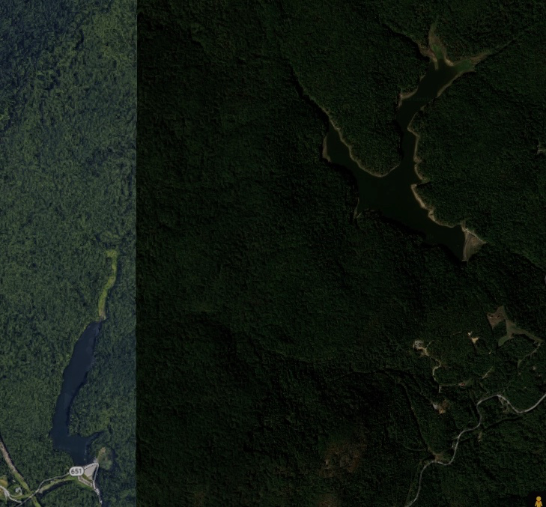
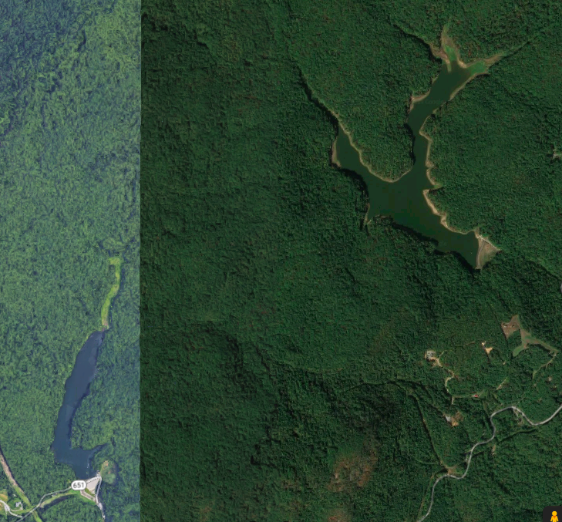
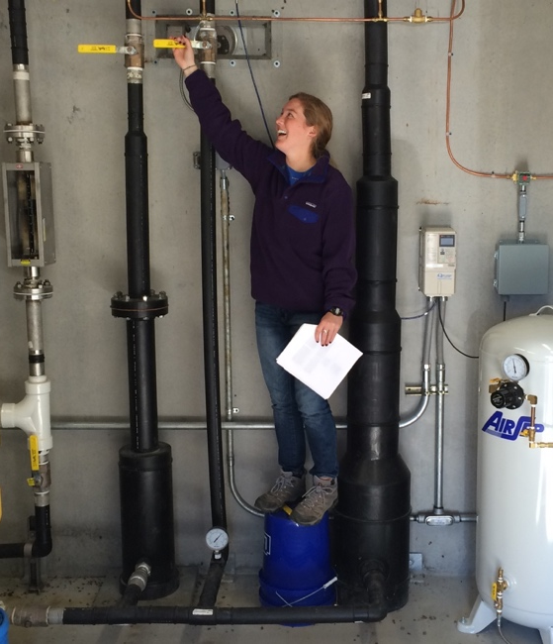
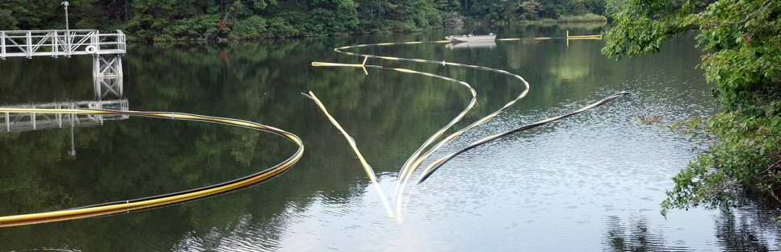

Whole-ecosystem oxygenation experiments
Beaverdam Reservoir
Falling Creek Reservoir
1 km

Slide 8
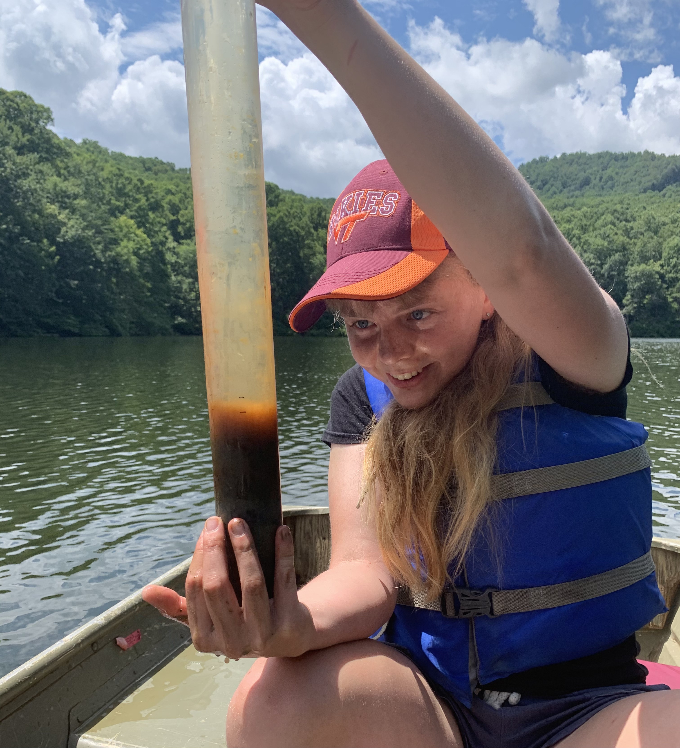
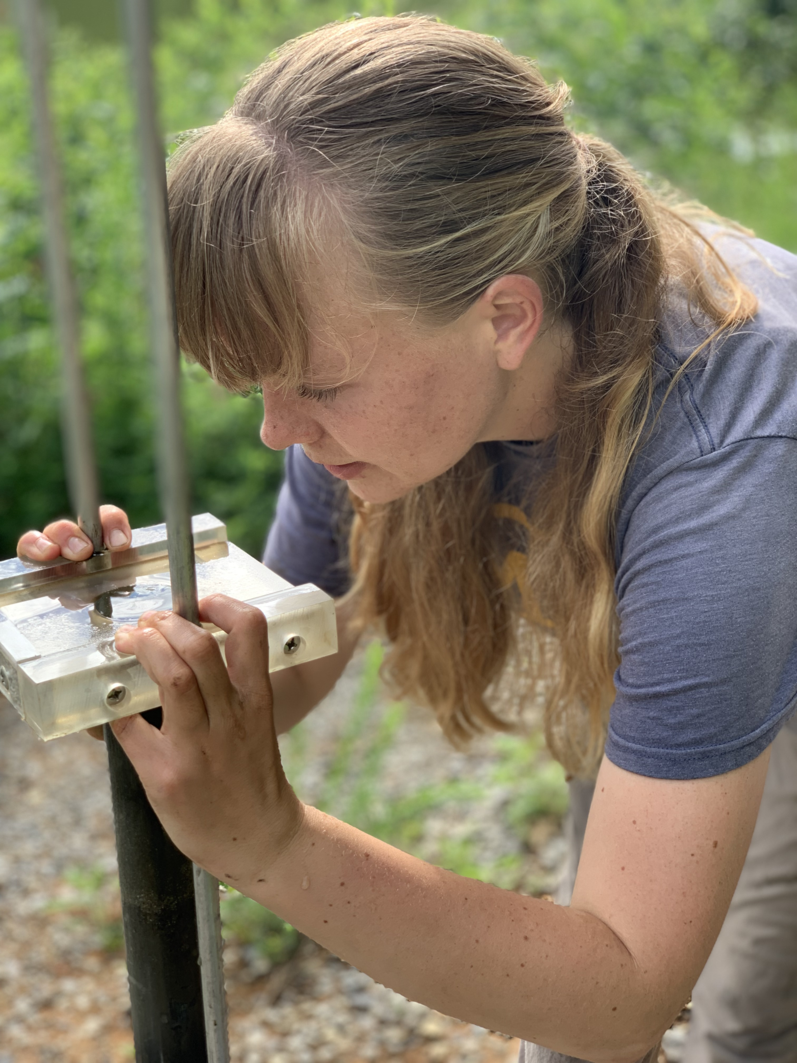
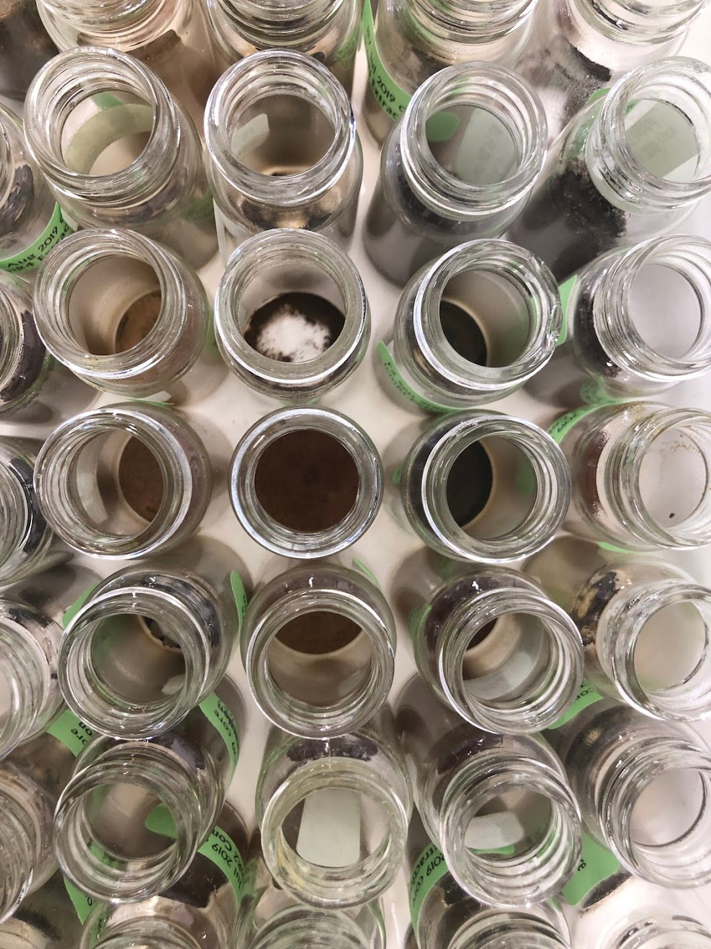
Sediment cores and chemical extractions used to assess effects of oxygenation

Slide 9
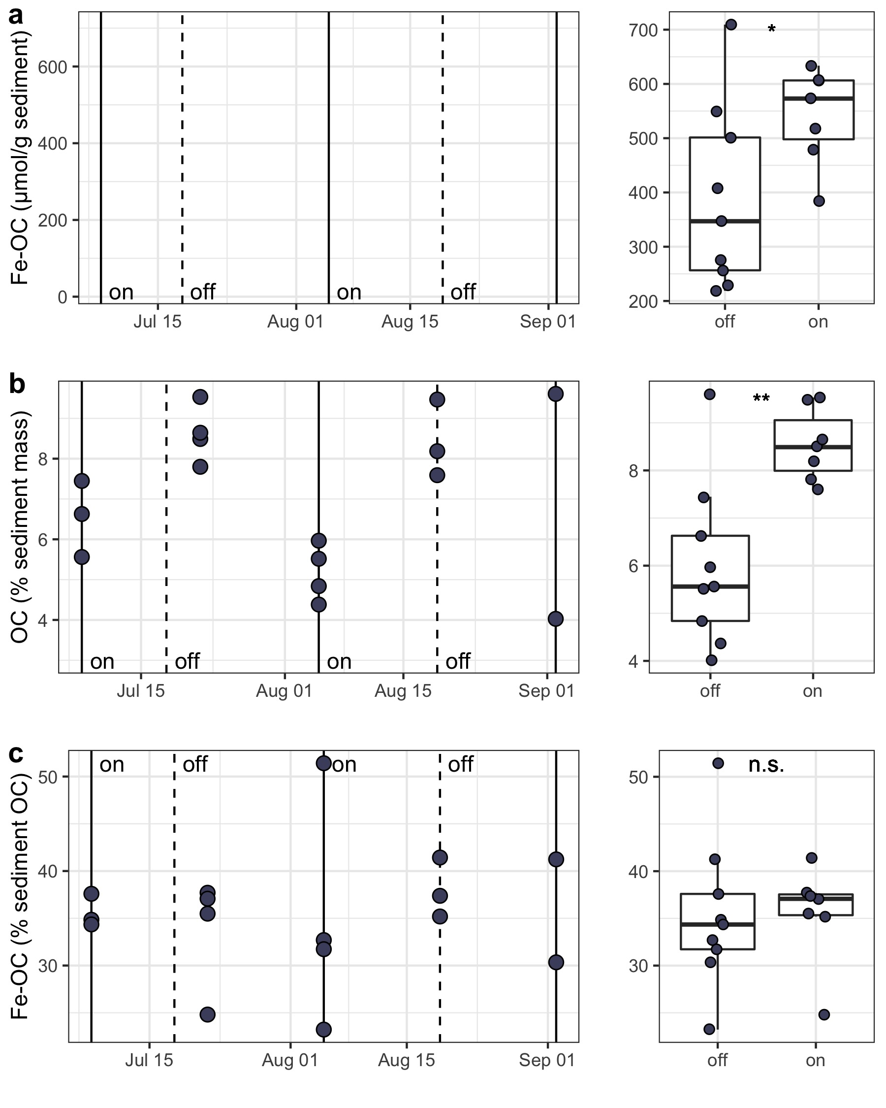
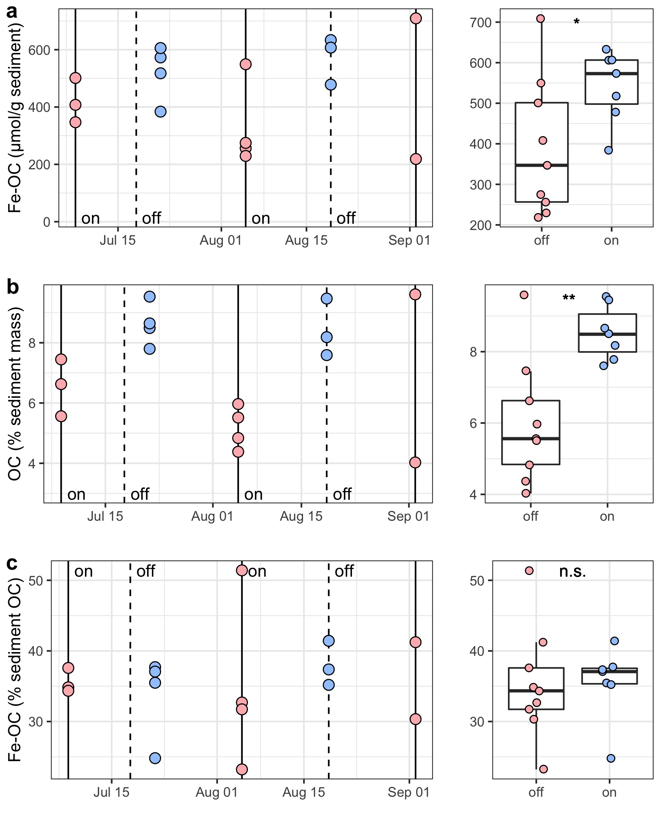
Over short timescales, low-oxygen conditions decrease carbon burial
Iron-bound organic carbon
(µmol/g sediment)
Organic carbon
(% sediment mass)

Slide 10

Over short timescales, low-oxygen conditions decrease carbon burial
Iron-bound organic carbon
(µmol/g sediment)
Respiration
Mineral protection
Organic carbon
(% sediment mass)
Notes:
Color dots blue and red, add color to boxplot

Slide 11
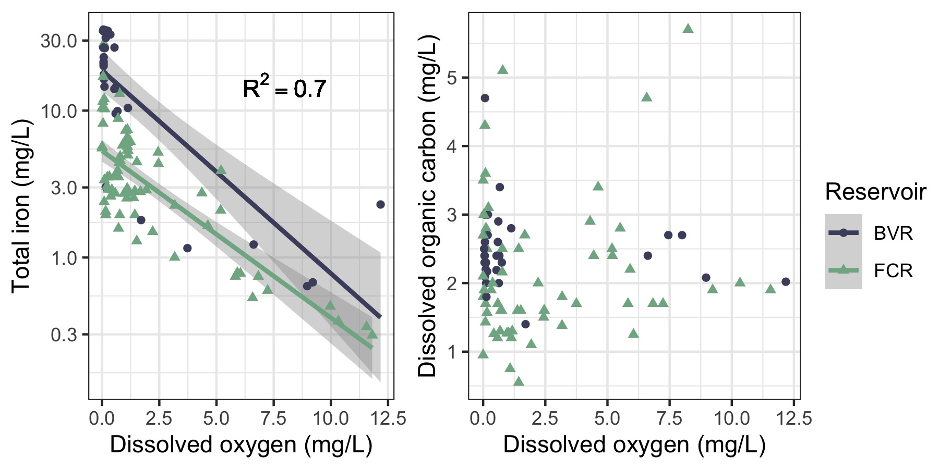
Anoxia leads to release of iron from sediments
Notes:
Include other years??? Different model
Cut???

Slide 12
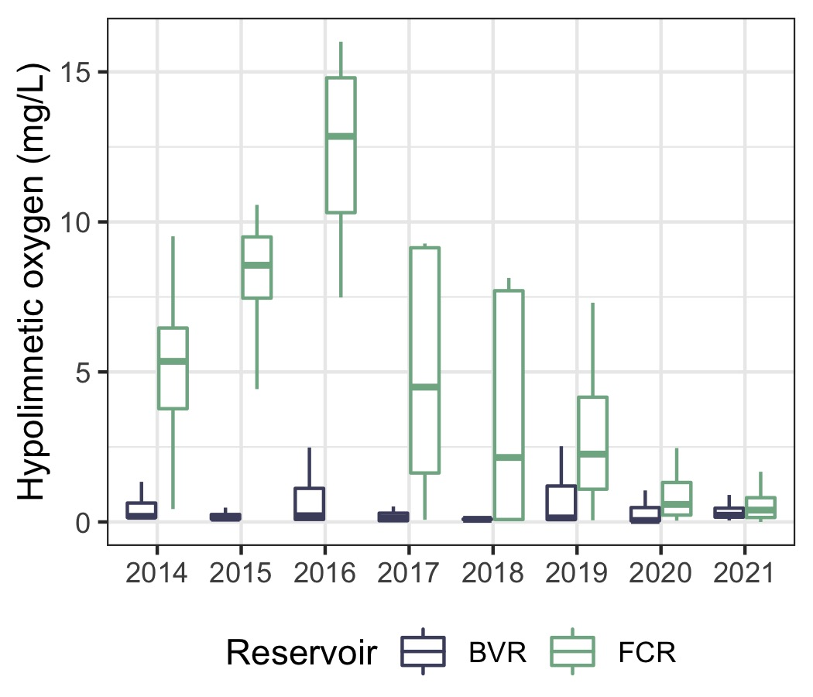
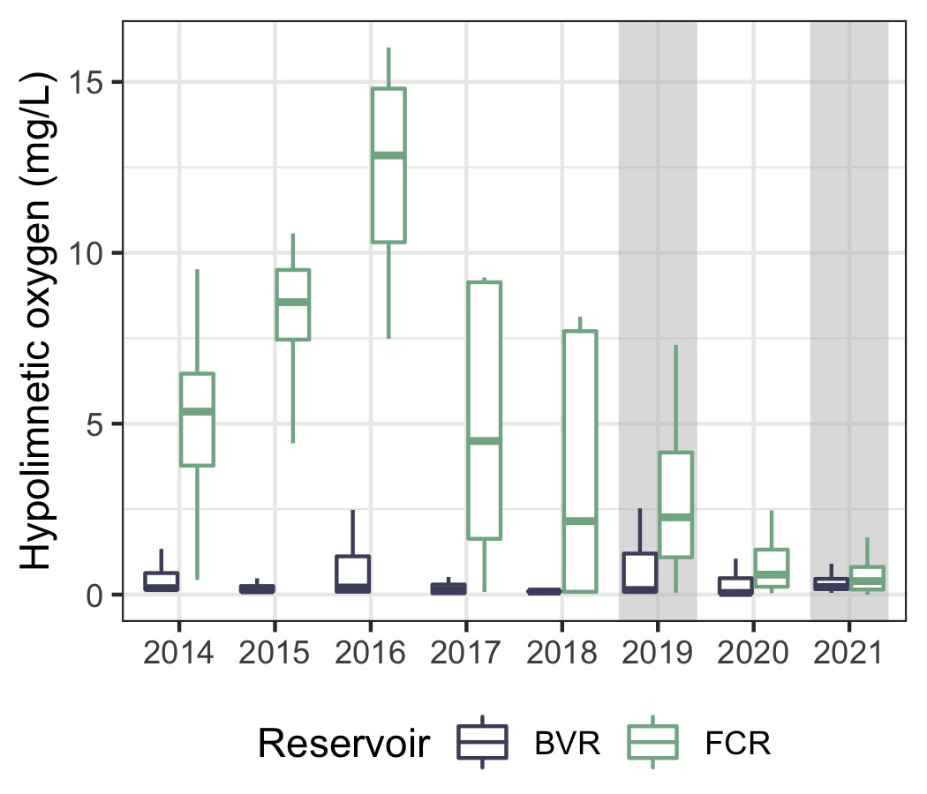
Multiannual oxygenation history provides a basis for understanding long-term effects of hypoxia
Bottom-water oxygen (mg/L)

Slide 13
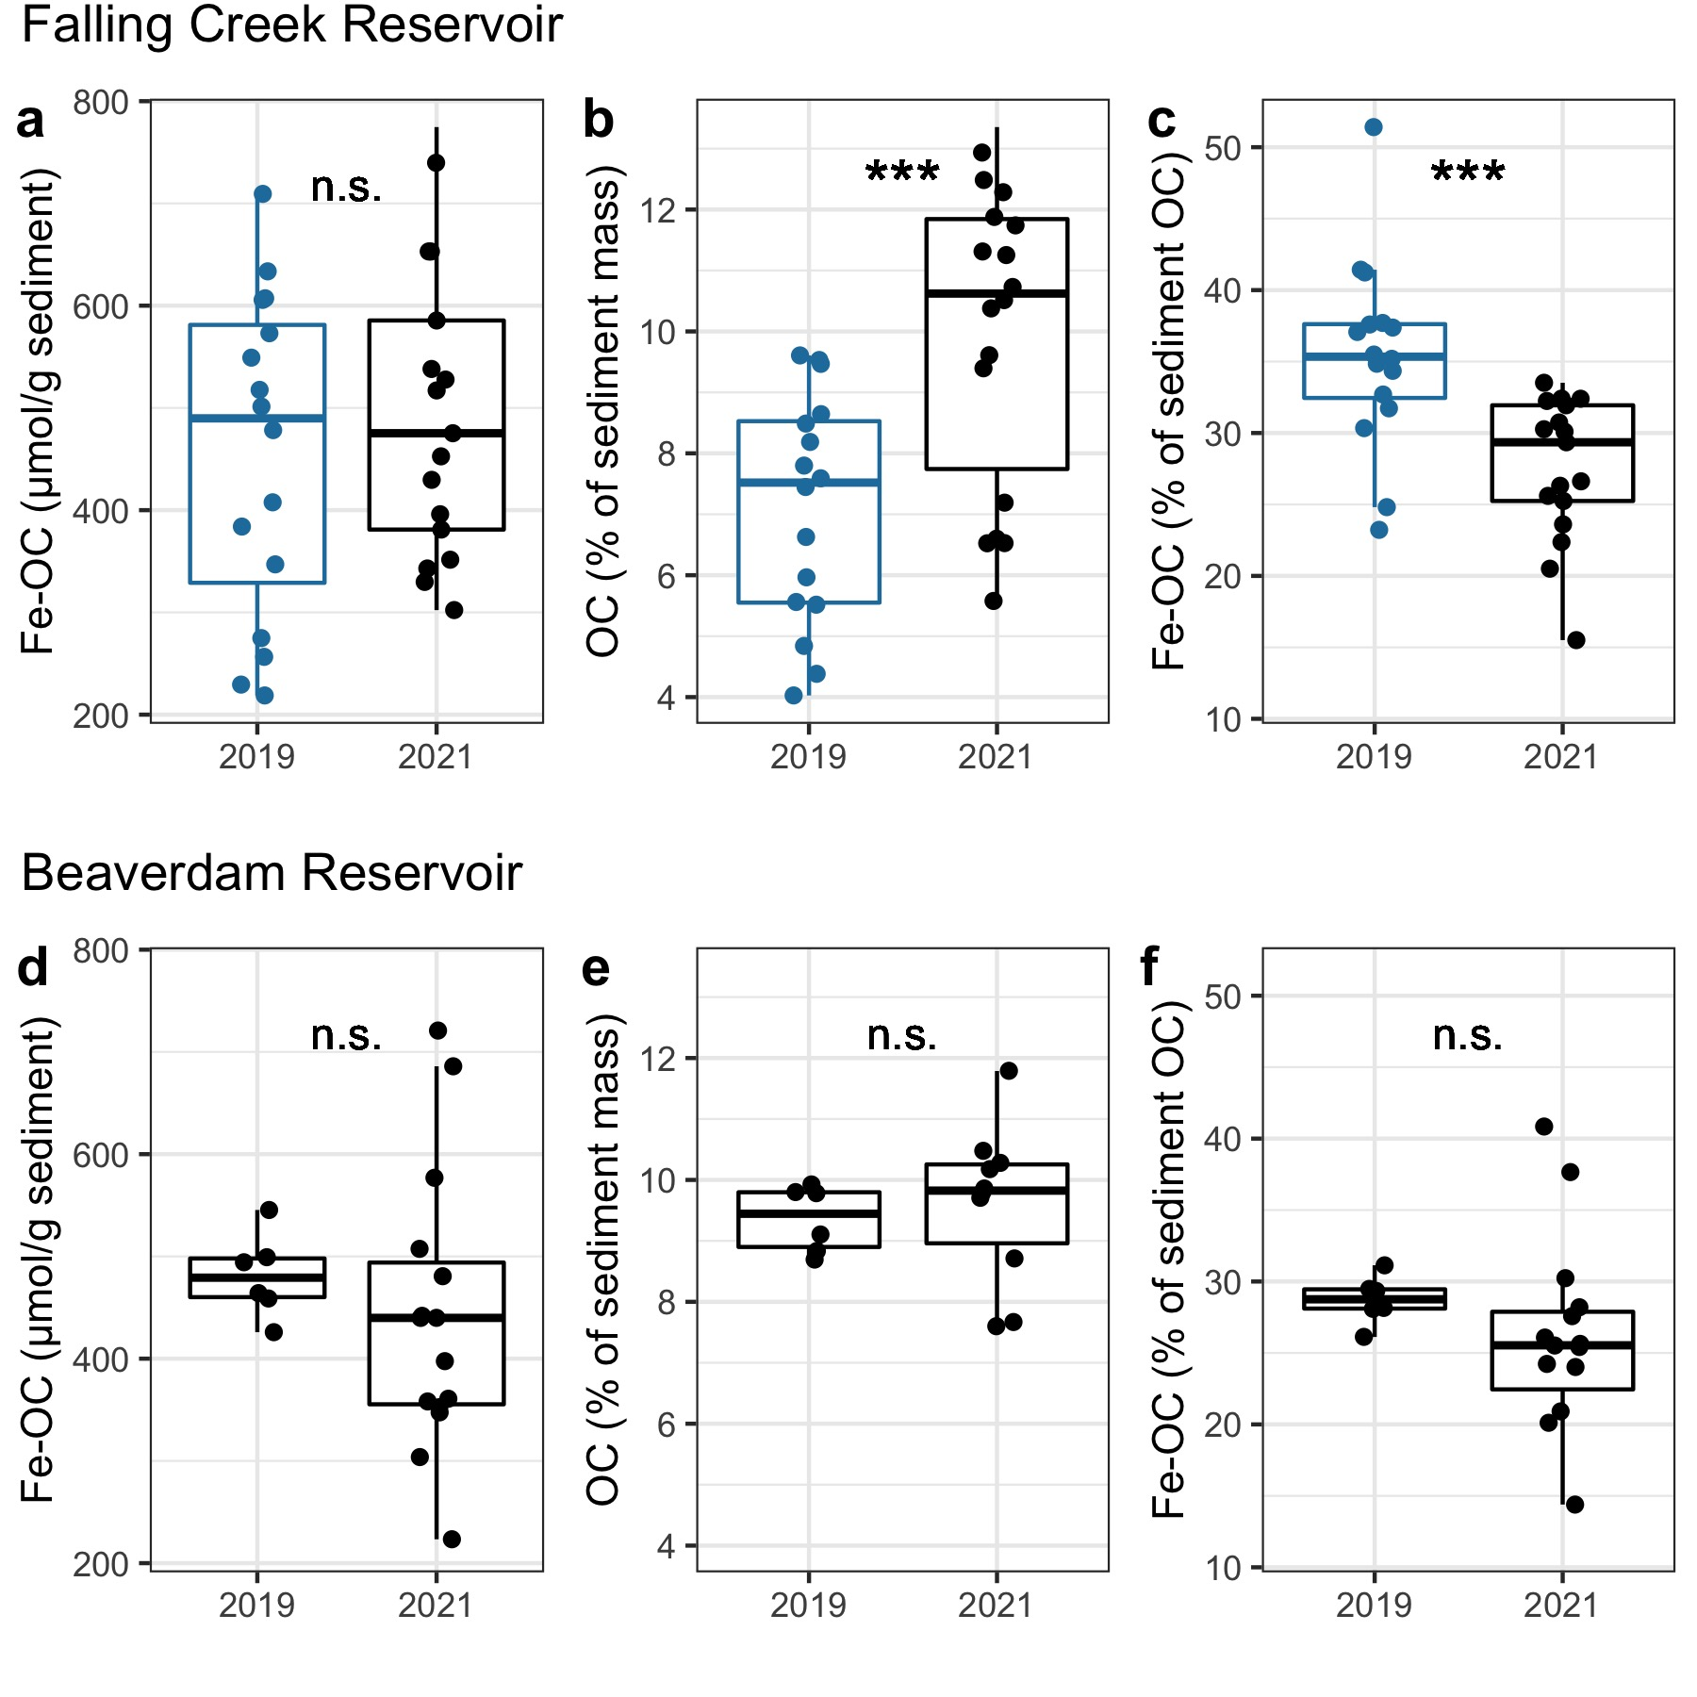
Over multiannual timescales, low-oxygen conditions increase carbon burial
Iron-bound organic carbon
(µmol/g sediment)
Organic carbon
(% sediment mass)
Iron-bound organic carbon
(µmol/g sediment)
Organic carbon
(% sediment mass)
(high-oxygen)
(low-oxygen)
Mineral protection
Respiration

Slide 14
Conclusions
Increasing anoxic duration may dramatically alter carbon cycling processes across the sediment-water interface
Anoxia increases carbon burial in sediments over multiannual timescales, likely decreasing carbon export and emission from freshwater reservoirs
Short-term (2-week)
Long-term (multiannual)
Respiration
Mineral protection
Mineral protection
Respiration
Notes:
Link image to carbon burial
Mention methane and OM structure/composition

Slide 15
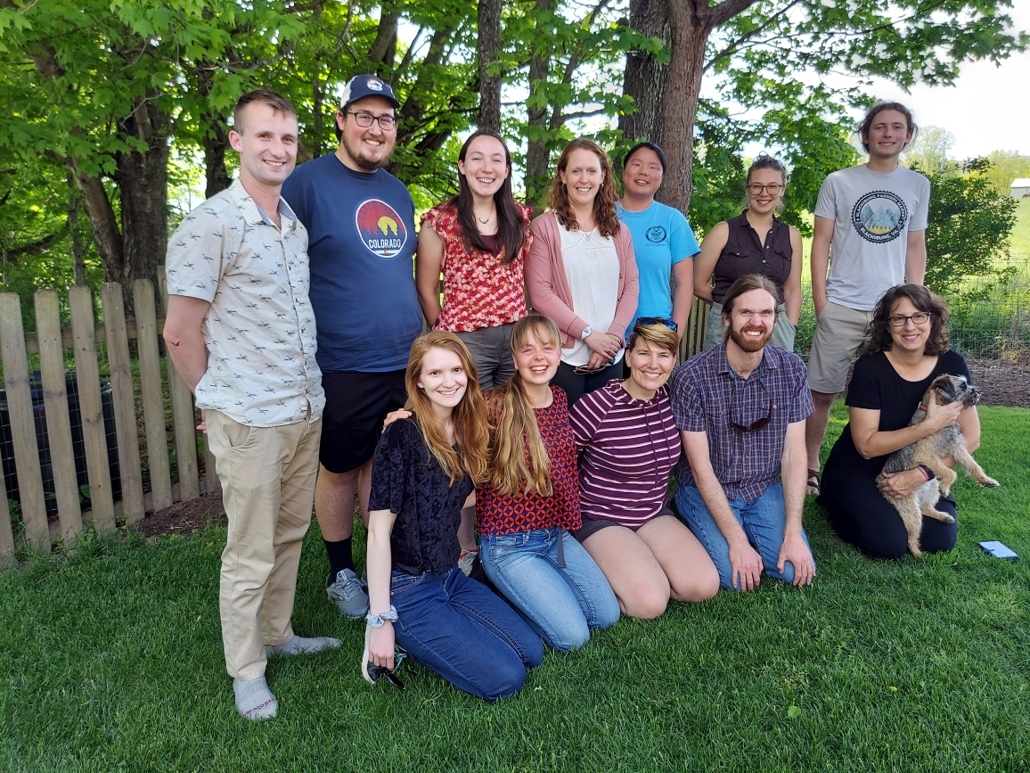

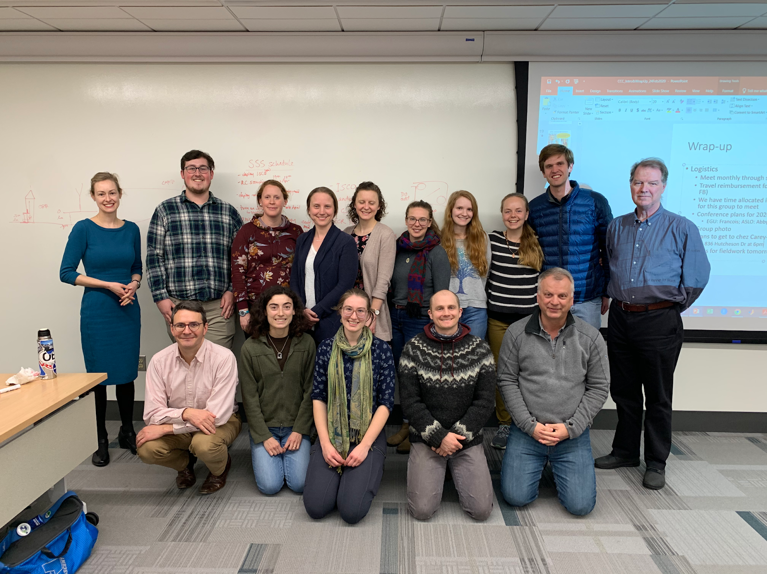

aslewis@vt.edu
@lewis_lakes
Notes:
I want to thank the Virginia Tech reservoir group for helping collect these data and the western Virginia water authority for allowing us to do work in their beautiful reservoirs. Thanks everyone for listening, and I’m happy to take any questions!

